Slide 1
California Healthier Living Webinar
Filling Workshops through Outreach and Social Media
June 23, 2015 2:00 – 3:30pm
Welcome!
Thank you for joining us today.
We appreciate your patience as we wait for others to join the webinar.
To use your computer’s audio:
When the webinar begins, you will be connected to audio using your computer's microphone and speakers (VoIP). A headset is recommended.
To use your telephone:
You must select "Use Telephone" after joining the webinar.
Call in using the numbers below:
Toll: +1 (702) 489-0003
Access Code: 446-253-659
Audio PIN: Shown on your screen after joining the webinar
  Webinar ID: 149-592-411

Slide 2
Agenda
Presentation | Presenter | Time | Minutes
Welcome | Lora Connolly | 2:00 - 2:10 | 10 minutes
Filling Workshops through Grassroots Marketing | Terry Brady | 2:10 - 2:35 | 25 minutes
Social Media 101: Hello! Is Anyone Out There? | Vivien Minton | 2:35 – 3:00 | 25 minutes
Questions and Answers | Terry Brady/Vivien Minton | 3:00 – 3:20 | 20 minutes
Closing Remarks | Lora Connolly | 3:20 – 3:30 | 10 minutes

Slide 3

Filling Workshops through Grassroots Marketing
Teresa J. Brady, PhD
Senior Behavioral Scientist
Arthritis Program
Centers for Disease Control and Prevention

Slide 4
Plan
What did we learn from audience research?
What is “grassroots” marketing?
How can I use successful participants as grassroots marketers?

Slide 5

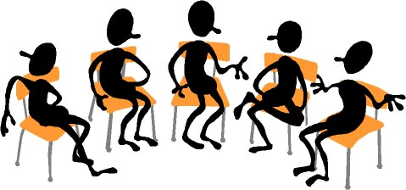
The imperative to….
… put “butts in seats”

Slide 6

Using the personal touch

Slide 7
Question
How do most participants learn about your workshops?

Slide 8
Question
How do most participants learn about your workshops?
Word of Mouth

Slide 9
How can we create more word of mouth “buzz”?

Slide 10
Audience Research
58 Focus Groups
Approximately 455 participants
5 projects
  Arthritis-specific
    Attitudes toward Self Management
    Understanding attitudes toward AF programs
    What do Consumers Want?
    Exploring the Value Proposition for Self Management Education
  Exploring feasibility of SME Awareness campaign

Slide 11
Typical Participant
Male or female
Black or white
  Some included Hispanic
Ages 45-70
Mix of education and income
Self report of Dr. Dx. of arthritis
  Some limitations due to arthritis
  60-80% report at least 1 co-morbidity

Slide 12
Audience Research
Key Learning #
Consumers unaware SME workshops exist.

Slide 13
The Consumer Perspective
SME Program Awareness
Self management/skill development not top of mind
Vast majority never heard of self help courses (surprised they exist)
Never looked for a course
  Assume arthritis is something to be tolerated, not actively managed
  If it existed, someone would have already told them (particularly Dr.)

Slide 14
Audience Research
Key Learning #
Preferred message carrier—someone like me.

Slide 15
The Consumer Perspective
Preferred Message Carriers
Someone like me
  Preferably someone I know
Who has a condition/situation like mine
Who has benefited from the intervention
“the voice of experience”

Slide 16
Audience Research
Key Learning #
Preferred Description:
Workshops…
to help you learn…
techniques or strategies…

Slide 17
The Consumer Perspective
Preferred Descriptors of SME classes
Self management (not self help or self care)
Help you learn (rather than “teach” or help build skills)
Workshop (not classes or course)
Call these techniques or strategies (not tools or skills)

Slide 18
Audience Research
Key Learning #
Bothersome symptoms, threats to valued activities, desire to “feel better” motivate action.

Slide 19
The Consumer Perspective
Motivators for action
Reducing pain, limitations, fatigue*
Increasing mobility
Maintaining independence
Maintaining valued life activities, *get on with my life
* From research with various chronic conditions

Slide 20
Audience Research
Key Learning #
Current Stanford SME workshops have attractive characteristics.

Slide 21

The Consumer Perspective
Desirable characteristics of SME
Topics to make course worthwhile
  Ways to reduce pain
  Benefits of exercise and how to exercise safely
  Things to help person move more easily and be able to do more
  Gaining sense of control over arthritis
    Especially pessimists
Share experiences/learn from others

Slide 22
Summary: Consumer Perceptions toward SME
Most unaware it exists
  Concept unfamiliar
  Programs invisible
Have not sought out classes; expect Dr would have told them
Topics covered and interactive processes in existing programs desirable
Prefer to hear from “someone like me”

Slide 23
How can we create more word of mouth “buzz”?
Grassroots Marketing!

Slide 24
Grassroots Marketing
Targeted approach to educating members of a population about product or idea.
Conducted by member of community through presentations or one-to-one outreach
“Sales” force made up of enthusiastic people with experience with the product

Slide 25
“Word of Mouth” Marketing…
…depends on people talking to people. The credibility of the message depends on the credibility of the messenger.

Slide 26
How can we create more word of mouth “buzz”?
Recruit, train
and support “Ambassadors”

Slide 27
What is an Ambassador
Person
Who has benefitted from the program
Is willing to promote it formally or informally to others they think could benefit.
…a “walking billboard”
Come to CDSMP…

Slide 28
Keys to Success in Ambassador Outreach
Having successful participants who serve as trained ambassadors to promote SME workshops
Using consumer audience research to shape the “pitch”
Providing training and ongoing support to ambassadors

Slide 29
Two Types of Ambassadors
Person to Person Ambassadors
  One-to-one approach to people they know and think would benefit
  Outreach to influential others (personal MD, minister, hairdresser)
Spokesperson Ambassadors
  Scheduled presentations for community groups
  Ambassador-identified opportunities in groups she is a member of

Slide 30
Characteristics of Ideal Ambassadors
Experienced—successfully completed SME workshop
Enthusiastic— a believer in the benefits
Connected—lives in community, respected by a wide circle of peers
“Wired to talk”; willing to share experiences
Spokesperson—comfortable speaking to groups

Slide 31

Spread the Word
Marketing
Self Management Education
through Ambassador Outreach

Slide 32
Spread the Word Components
Coordinators Guide
Handbooks
  Person to Person Ambassador
  Spokesperson Ambassador
Tools to support Coordinators and Ambassadors
Available at: http://www.cdc.gov/arthritis/ interventions/marketing-support/index.html

Slide 33
Summary
Most consumers not aware SME workshops exist
  Want to learn from “people like me”
Grassroots marketing can create “word of mouth” buzz
Participants can be good “ambassadors” to promote programs
Spread the Word guide can help you train and support your ambassadors

Slide 34

Contact Information
Teresa J. Brady, PhD
Senior Behavioral Scientist
Arthritis Program
Centers for Disease Control and Prevention
4770 Buford Hwy NE MD K-51
Atlanta GA 30345
770-488-5856
tob9@cdc.gov
770-488-5856

Slide 35
Social Media 101:
Hello! Is Anyone Out There?
Vivien Minton
Communications Manager
Partners in Care Foundation

Slide 36
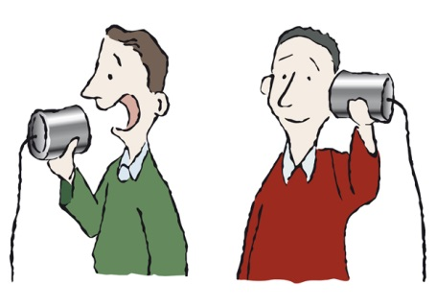
What is social media?
Social media is people using online community groups (like Facebook and Twitter) to share info with each other
Simply, it’s people having a conversation, online

Slide 37
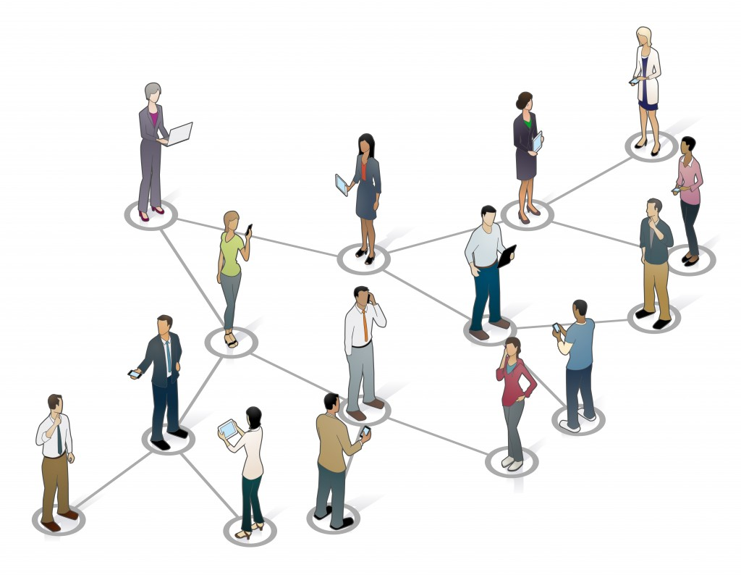
Why is that relevant to you?
People don’t know about the CDSME workshops
How do most participants learn about health self-management workshops?
Word of mouth
Social media IS word of mouth, online

Slide 38
How do we know it’s relevant?
Facebook 2014
Twitter 2014
208 million active users in US
71% of all adults online are on FB (58% of entire population)
85% of all sharing activity happens on FB
56% of online users aged 65+ use FB, up from 45% in 2013 and 35% in 2012
53 million active users in US
23% of all adults online are on Twitter, up from 18% in 2013
10% are 65+ up from 5% in 2013
http://www.pewinternet.org/2015/01/09/demographics-of-key-social-networking-platforms-2/

Slide 39
Ok, but how can I use social media to put butts in seats?
Engage with people who are relevant to you and make them AMBASSADORS

Slide 40




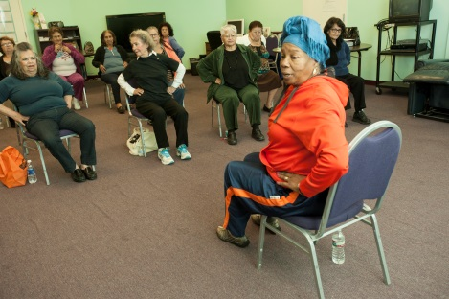

Who are your ambassadors?
Workshop leaders
Successful participants
Master trainers
Charities/advocacy groups (AARP, Arthritis Fndn, Diabetes Assn…)
Local community groups (churches, reading groups, libraries, community centers…)
Health plans, physician groups, MDs
Your organization
You!

Slide 41
How do you engage with them?
Using the 60/30/10 rule

Slide 42
60% should be content you CURATED
30% should be content you CREATED
10% should be CALLS TO ACTION

Slide 43
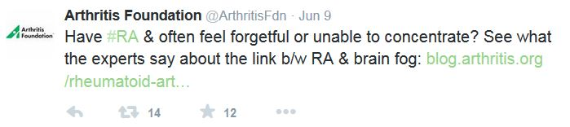
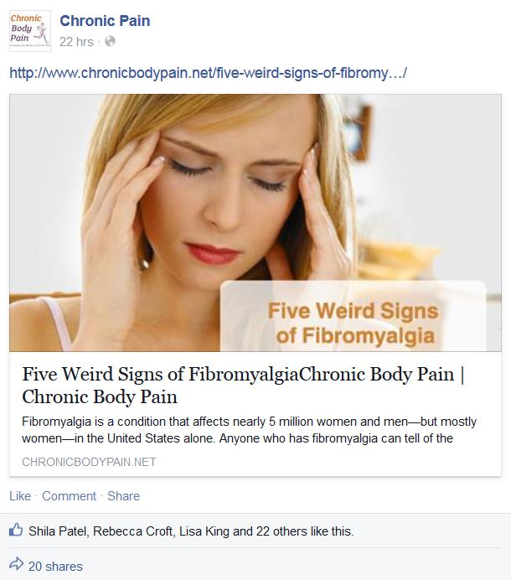
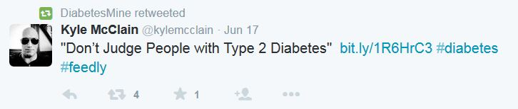
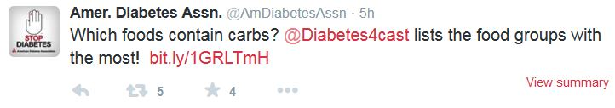
60% curated? What does that mean?
That 60% of your social media activity should be content created by others that’s relevant to your community.

Slide 44
Why?
Because it allows you to ENGAGE with your community on a topic that’s relevant to THEM
Because it helps develop your trustworthiness and CREDIBILITY
Because it INFORMS your community and provides them with information that’s of VALUE

Slide 45
And most importantly…
Because effective communication on social media is
NOT ABOUT THE HARD SELL

Slide 46
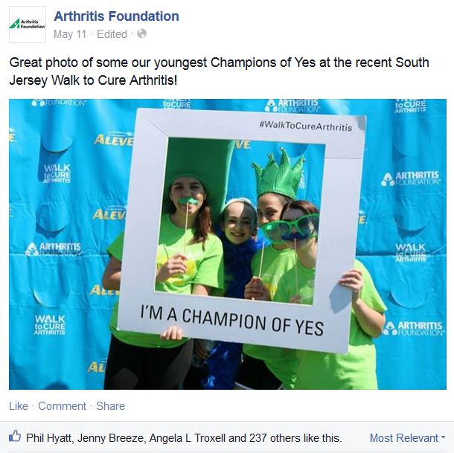
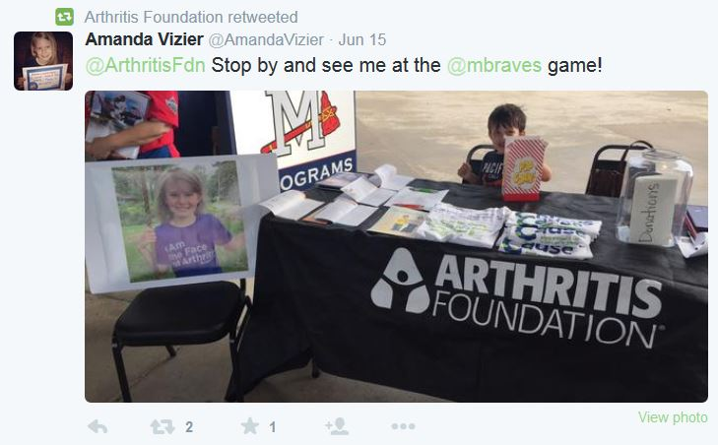
30% created? Help!
30% of your social media activity should show what you do and how it’s successful
A photo/s and mini case study, posted to Facebook
A ‘fun fact’ and a picture from a workshop posted to Twitter

Slide 47
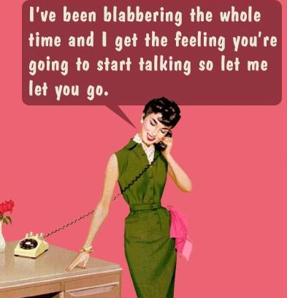
Why only 30%?
Because people want to see and hear about what you do (and can do for them)
But they won’t listen if you talk about yourself all day long
And you may not have enough created content

Slide 48
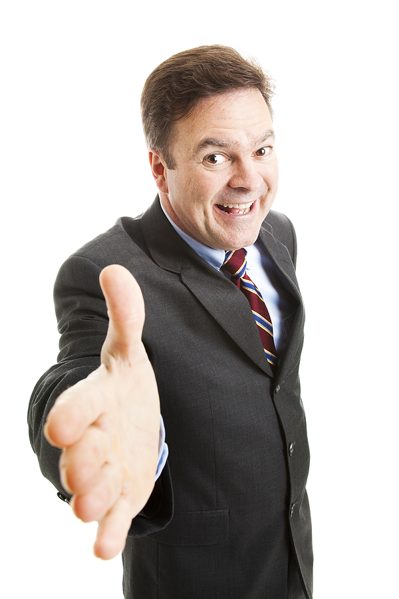
10% call to action
Because you want butts in seats
But too much selling (even if it’s for something that’s really good) is a big turnoff

Slide 49
Ok! So where do I start?
Keep it simple

Slide 50



Slide 51
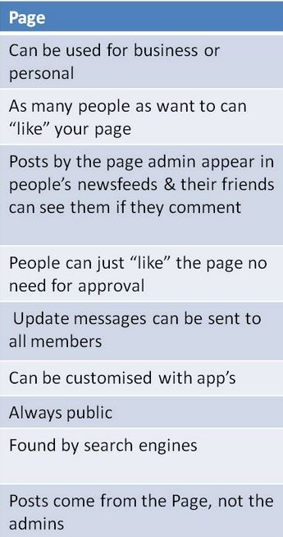
Facebook
Create a PAGE (not a profile) for your workshops

Slide 52
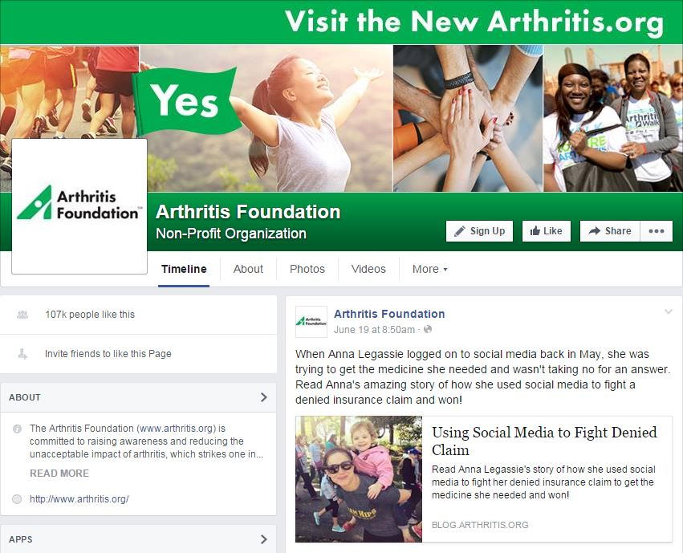

Add a header image, a logo (if you have one) and a blurb ABOUT your program
Search for organizations that are relevant to you and
their pages

Slide 53
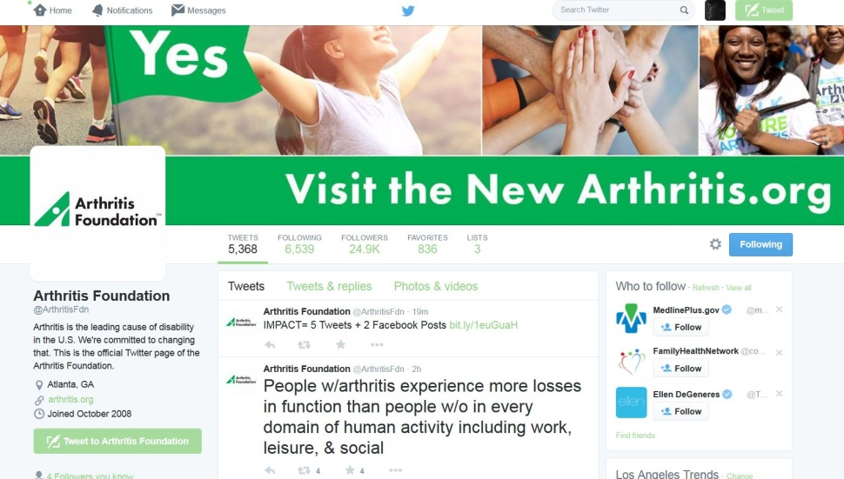
Twitter
What can I do with only 140 characters?
  Create awareness
  Connect @ w/ambassadors, partners and influencers
  Find # people and organizations that can help you
  Retweet their content RT@ to build relationships with them

Slide 54

How do I do that?
Set up a Twitter account by selecting a name (keep it short), an image and a quick blurb
Use the hashtag # symbol to search for topics relevant to you eg: #diabetes #arthritis #chronicpain
Then start following people / organizations that tweet about topics relevant to you
You’ll probably find they’ll start following you too!
Use the at @ symbol to tweet a public message to another user eg: @ArthritisFdn
Retweet relevant content using RT@

Slide 55

Understanding Twitter etiquette
Twitter is a public, searchable forum, so be nice!
Quality over quantity (watch your 60/30/10 ratio)
Acknowledge supporters or other organizations trying to do good in your field using @
Follow people and organizations that follow you (as long as their tweets are relevant)

Slide 56

About that content…
Ask yourself:
  What happened this week that was interesting/ entertaining and invites conversation?
  What did you do to help someone achieve success?
  What advice have people been asking you for?
  What new research/ data/ information can you share from other relevant organizations?
  What’s happening RIGHT NOW that you can tweet an image of or post to Facebook?

Slide 57
Build a content plan
 | Mon | Tues | Weds | Thurs | Fri
Week 1 | Beginning of Diabetes Awareness Month. Post support and workshop image #stopdiabetes | RT @ Share | Photos of Santa Clarita healthier living workshop | RT @ Share | Announce new workshop date
Week 2 | Post diabetes-friendly recipe for #meatlessmonday | Photo and mini-case study of Maria’s journey with diabetes | RT @ Share | New workshop dates reminder | RT@ Share

Slide 58
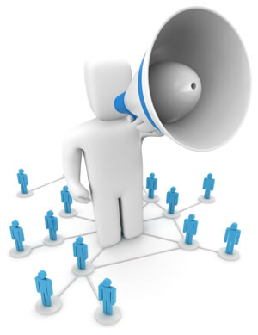
Tell other people that you’ve gone social!
Send out an email/e-blast to your contact database
Get a blurb in your organizations newsletter/ blog/ webpage
Add social media icons to all your emails
Engage your own team to spread the word
Tell your own network of people!

Slide 59
Summary
Just beginning? Start with Twitter and Facebook
Build a content plan
Use images. A LOT!
Remember the 60/30/10 rule
Be nice
Be responsive
Make it easy for people to find and follow you
Tell people that you’re there!
Be patient

Slide 60
Thank you!
Questions?

Slide 61
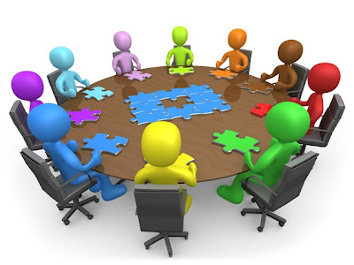
QUESTIONS?
Comments?
Discussion?

Slide 62
CA Healthier Living
Webinar & Meeting Dates
Webinars
Tuesday, September 15, 2015 @ 2:00 – 3:30 pm
In-person Annual Meeting
Wednesday, November 18, 2015
9:30 am – 3:30 pm

Slide 63
Lora Connolly
Director
CA Department of Aging
Lora.Connolly@aging.ca.gov
Teresa J. Brady, PhD
Senior Behavioral Scientist
Arthritis Program
Centers for Disease Control and Prevention
tob9@cdc.gov
Vivien Minton
Communications Manager
Partners in Care Foundation
vminton@picf.org
Natalie Zappella, MUP, MSW
Health Innovations Program
Program Director
nzappella@picf.org
Kathryn Keogh, MPH
Project Manager
Health Innovation Programs
Partners in Care Foundation
kkeogh@picf.org
Barb Heinzel, MPH, CHES
Project Associate
Health Innovation Programs
Partners in Care Foundation
bheinzel@picf.org

Slide 64
Thank you!

