Slide 1
California Healthier Living Coalition Meeting
Lora Connolly
California Department of Aging
November 17, 2015

Slide 2
California Healthier Living Coalition
MISSION
Support and enhance statewide access to evidence-based programs for adults with chronic health conditions and disabilities.
In collaboration with health delivery systems, agencies providing aging service, and other community based organizations:
  Increase awareness, referrals, and access to these programs, particularly in underserved communities;
  Develop regional program networks providing these programs throughout California; and
  Identify and secure funding resources to sustain these programs.

Slide 3
California
Administration on Aging Grant Milestones
2014
2013
2012
2010
ACA
PPHF
Falls Prevention
Grants
National
Falls Prevention Resource Center
Established
Affordable Care Act Prevention and Public Health Fund
CDSME Grants
Diabetes Self-Management Training
&
Business Acumen Technical Assistance
2006
2003
Putting Prevention to Work:
CDSMP Recovery Act Grants
Evidence-Based Prevention Program
& Atlantic Philanthropies
grants
Evidence-Based Program (EBP) Pilot
&
National
EBP Resource
Center
Established

Slide 4
California CDSME Goals
AoA-PPHF Grant
Source: 2014 National Council on Aging Database
Notes:
State completer deliverables based on Federal funding
Lora – what number would you like to use for the ‘overall goal’? (7,804 is our current goal; 8,518 after 1st sequestration cut (for some reason I have two); 9,189 original proposal submission)

Slide 5
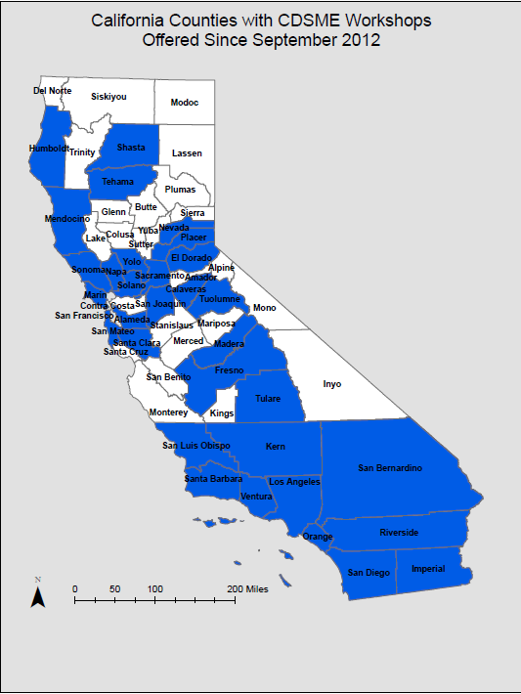
California
Chronic Disease Self Management Education Workshops
(2012-2015)

Slide 6
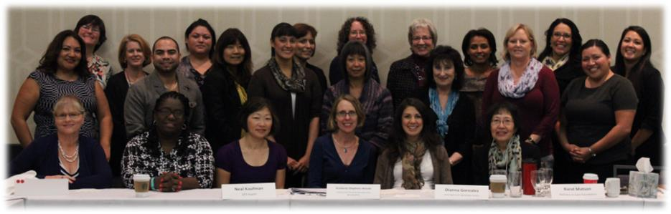
Thank you
California Healthier Living
Coalition Members
24,676 people participated in CDSME programs, reaching 27,281 completers through 2,673 workshops held across California in 33 counties
Source: National Council on Aging Database 2010 - 2015

Slide 7
Sustaining What We Have Been Building Together
Leveraging resources for shared technical assistance, program leader training, licenses, tools and lessons learned;
Identifying EB CDSME Programs that are the best fit in terms of meeting community needs and sustainability;
Ongoing advocacy for tools that empower individuals to better manage their own chronic conditions; and
Fostering a network of regional coalitions that provide these program to facilitate contracting with health plans and other purchasers.

Slide 8
Integrating Chronic Disease
and Fall Prevention Programs
Lifestyle Risk Factors
Chronic Diseases
Medication Side Effects/Activity Limitations
Falls

Slide 9
Strong research indicates that most chronic conditions both directly or indirectly significantly increase fall risks:
Functional limitations and disabilities
Chronic pain
Impact on vision and sensory deprivation
Balance and gait disturbances
Depression
It is estimated that chronic diseases may account for 30% of falls through direct effects of the disease and indirect effects, such as reduced physical activity, muscle weakness, and poor balance.
            Lawlor, et. al. 2003

Slide 10
Interaction Between Fall Risk and Chronic Disease Management

Slide 11
Integrating Chronic Disease & Fall Prevention Programs
Critically important for:
Patients to gain the knowledge, skills, and support to improve their health, remain active, gain confidence, & prevent disability
Health care providers to activate patients to participate in self-management and meeting national quality measures (HEDIS, CMS 5-Star rating, CAPS, Avoidable readmissions, etc.
Community-based organizations to improve the quality of life of older adults and adults with disabilities
The national health care system to achieve the Triple Aim goals

Slide 12
Program Integration Advantages
Recruitment
  At Risk Participants
  Partners in Offering EBHP programs (sponsors/providers)
Referrals – draws in allies outside existing well used
networks
Provides a more comprehensive approach to complex challenges
Reinforces behavioral changes – which need ongoing reinforcement

Slide 13
The Challenge
Move forward with determination and creativity
  Draw upon our beliefs and proven success
Assess together:
  Available resources
  Statewide needs for technical assistance
  Round table discussion this afternoon

